Slide 1
HSA Programming Model: HSA Runtime and HSAIL
TA: Jiun-Hung Ding
Instructor: Yeh-Ching Chung
SSLAB

Slide 2
HSA Runtime

Slide 3
HSA Runtime
The runtime system contains the user mode management software required to execute a compiled HSA program
  Information required in the compilation unit to execution on queues
  Abstracts HSA Component functionality
  Exposes HSA features to developers of applications, libraries and programming tools

Slide 4
HSA Core API
Thin layer that abstracts a common set of HSA features
Composition and support for different higher-level functionality that various programming models and languages can in turn be built on top of
It is a
  Portable target to higher-level services
  Subsystems
  Programming model
  Language runtime systems

Slide 5
HSA Systems Architecture Spec
Specify a set of requirements that form the minimal feature-set
These features must be abstracted via API to enable users to program and utilize
Helps setup the execution via API calls and data structures to support architected features

Slide 6
HSA Feature
Shared Virtual Memory
Cache Coherency Domains
HSA Platform Topology Discovery
Memory-Based Signaling and Synchronization
User Mode Queuing
Preemptive HSA Component Context Switching
Architected Queuing Language (AQL)
HSA Component IEEE754-2008 Floating Point Exception Reporting
HSA Component Hardware Debug Infrastructure
Efficient Syscall Infrastructure

Slide 7
Core API as an Infrastructure
Support for execution control
Architected dispatches
  Provide a high-performance dispatch mechanism.
Portable across multiple HSA vendor architectures
  Run the same unmodified binary for same host ISA but different HSA-compliant GPUs
  Support the HSA-architected AQL interface
  Supply a library that implements the architected core runtime API

Slide 8
Architected Dispatch
Architected dispatch is the key feature in an HSA system
  Enables a user-level application to directly issue commands to the HSA Component hardware
Different points from other higher-level runtime systems
  Others provide software APIs for setting arguments and launching kernels
  HSA architects these at the hardware and specification level
Dispatch mechanism is architected at the HSA hardware level
  Regular memory operations and runtime provided wrapper API
User only need to do
  Creates user mode queues and an AQL Packet in memory
  Signals the HSA component to begin executing the packet using light weight operations

Slide 9
Execution Flow

Slide 10
Step1: Initial Setup
Device discovery
  Information available to the user as data structures
Create the component queues
  Queues are an HSA architected mechanism to submit work to the HSA component HW

Slide 11
Structure declaration
unsigned int count;
uint32_t kernel_directive = atoi(argv[2]);
uint64_t kernel_input = (uint64_t)atoi(argv[3]);
const hsa_agent_t *component_list = NULL;
const hsa_agent_t *component = NULL;
static hsa_aql_dispatch_packet_t dispatch_packet;
hsa_runtime_context_t *runtime_context;
hsa_status_t status;
hsa_queue_t *queue;
hsa_brig_t *brig = (hsa_brig_t *)argv[1];
hsa_code_object_t *code_obj;
hsa_symbol_map_t *symbol_map;

Slide 12
Setup a Dispatch
/**** this part is the setup for a simple dispatch ****/
status = hsa_open(NULL,NULL,NULL,NULL,&runtime_context);
assert(status == HSA_STATUS_SUCCESS);
status = hsa_component_get_list(&count, &component_list);
if(count <= 0 || status != HSA_STATUS_SUCCESS) {
assert(HSA_STATUS_SUCCESS == hsa_close());
exit(1);
}

Slide 13
Select Component and Create Queue
component = &component_list[0];
status = hsa_queue_create(component, 1024, 0, runtime_context,
&queue);
if(status != HSA_STATUS_SUCCESS) {
assert(HSA_STATUS_SUCCESS == hsa_close());
exit(1);
}

Slide 14
Step2: Compilation Flow
Kernel format
  HSAIL program
  Generated by a higher-level compilation step
Assembled to generate a BRIG
  BRIG is the HSAIL object format
Compile the BRIG and generate a code object that can has sufficient information to execute the user program

Slide 15
Finalize Kernel
/**** this is the compilation part where the brig is finalized
****/
status = hsa_finalize_brig(component, brig, kernel_directive,
NULL, NULL, &code_obj, &debug_info, &symbol_map);
if(status != HSA_STATUS_SUCCESS || symbol_map != NULL) {
assert(HSA_STATUS_SUCCESS == hsa_queue_destroy(queue));
assert(HSA_STATUS_SUCCESS == hsa_close());
exit(1);
}

Slide 16
Step3: Execution of Kernel

Slide 17
Task Packet Format
Specifies the structure of the packets (i.e. commands)
  Placed on the HSA user mode queues for the component HW to execute
The format of the packets is architected
  Architected Queuing Language (AQL) packets

Slide 18
Create an AQL Packet
Initialize it with the code object obtained from the finalization step, including the allocation of memory to hold the kernel arguments and the spill/arg/private memory

Slide 19
HSAIL ABI
Interface for kernel arguments between the runtime and the kernel ISA is also architected
HSAIL ABI (Abstract Binary Interface)
  Specify the in-memory layout of the kernarg segment
  Determine the layout of the kernarg memory segment at compile time by examining the signature of the HSAIL function
Finalizer supports HSAIL ABI
  No need for runtime metadata to specify the position or format of arguments

Slide 20
AQL Packet Reused
Specifying the in-memory layout can be done once for each AQL packet creation for same kernel
Optimized implementations can cache the result of this step and re-use the AQL packet for subsequent launches
Care must be taken to ensure that the AQL Dispatch packet (and the associated kernel and spill/arg/private memory) is not re-used before the launch completes

Slide 21
AQL Dispatch Packet
For simple cases, (that is, a single-thread, synchronous launch, the AQL dispatch packet(s) can be declared as a static variable and initialized at the same time the code is finalized
More advanced cases can create and track several AQL Dispatch packet(s) for a single kernel code object

Slide 22
Doorbell Mechanism Inform HW
HSA HW define
  How to process these packets
  A doorbell mechanism to inform the HW that packets have been written into the queue
Core runtime defines a structure and update API to inform the HW that dispatch packet has been written to the queue

Slide 23
Start Execution
Once the packet is written and the HW is informed via. the doorbell, the execution can start
The execution happens asynchronously
The user is free to write more packets for executing other kernels in the queue
This activity can overlap the actual execution of the kernel

Slide 24
Create a Signal
/**** a signal is created for completion detection ****/
sigval.value64 = 0;
status = hsa_signal_create(sigval, &signal, runtime_context);
if(status != HSA_STATUS_SUCCESS) {
assert(HSA_STATUS_SUCCESS == hsa_queue_destroy(queue));
assert(HSA_STATUS_SUCCESS == hsa_close());
exit(1);
}

Slide 25
Write and Dispatch AQL Packet
/**** the AQL packet is setup here for the simple kernel ****/
dispatch_packet.header.format = 2;
dispatch_packet.header.barrier = 1;
dispatch_packet.header.acquire_fence_scope = 2;
dispatch_packet.header.release_fence_scope = 2;
dispatch_packet.header.dimensions = 1;
dispatch_packet.workgroup_size_x = 256;
dispatch_packet.grid_size_x = 256;
dispatch_packet.kernel_object_address = (uint64_t)code_obj;
dispatch_packet.kernarg_address = (uint64_t)(&kernel_input);
dispatch_packet.completion_signal = signal;
memcpy(queue->base_address, (void *)&dispatch_packet,
sizeof(dispatch_packet));

Slide 26
Inform Component
/**** packet processor is informed that a packet is on the queue
****/
index = hsa_queue_set_write_index(queue, 1);
if(index != 0){
assert(HSA_STATUS_SUCCESS == hsa_queue_destroy(queue));
assert(HSA_STATUS_SUCCESS == hsa_close());
exit(1);
}
sigval.value64 = 1;
status = hsa_signal_send_release(queue->doorbell_signal, sigval);
if(status != HSA_STATUS_SUCCESS) {
assert(HSA_STATUS_SUCCESS == hsa_queue_destroy(queue));
assert(HSA_STATUS_SUCCESS == hsa_close());
exit(1);
}

Slide 27
Step4: Determining Kernel Completion

Slide 28
HSA Signaling
Signals as a mechanism for communication between different parts of a HSA system
Core API are defined to send a value to the signal and wait for a value at the signal
AQL dispatch packet has a provision for the user to pass in an opaque signal

Slide 29
Waiting Mechanism
When the HSA Component HW observes a valid signal in the AQL packet, it sends a value to this signal when the execution of the kernel complete (success or error)
The user can wait on this signal to determine kernel completion

Slide 30
Wait Completion
/**** await completion ****/
do {
status = hsa_signal_wait_acquire(signal,HSA_EQUALS, sigval,
&sigval);
} while(status == HSA_STATUS_INFO_SIGNAL_TIMEOUT);
if(status != HSA_STATUS_SUCCESS) {
assert(HSA_STATUS_SUCCESS == hsa_queue_destroy(queue));
assert(HSA_STATUS_SUCCESS == hsa_close());
exit(1);
}
printf("\nkernel successfully executed, value %llu\n",
kernel_input);

Slide 31
Complete
/**** close up and destroy queue, close the runtime ****/
status = hsa_queue_destroy(queue);
if(status != HSA_STATUS_SUCCESS) {
assert(HSA_STATUS_SUCCESS == hsa_close());
exit(1);
}
status = hsa_close();
assert(status == HSA_STATUS_SUCCESS);
return 0;

Slide 32
Error and Notification

Slide 33
Errors Handling
Two categories:
  synchronous error handling
  asynchronous notification handling

Slide 34
Synchronous errors
Reported when the call returns which indicate if the API returned a success or an error
The HSA core runtime API defines an enumeration that captures the result of any API function
  success , info , error
Success status is a single value
  HSA_STATUS_SUCCESS
Every core runtime API call that returns hsa_status_t explains what the expected successful behavior for that API

Slide 35
Asynchronous Errors
Reason:
  (i) Triggered by activity in packet processor, executing kernels, their actions and memory accesses
  (ii) When an error is detected during the execution of a kernel, the completion signal will be signaled with an error indication value
  (iii) For providing information and this information may not necessarily indicate an error e.g., timeout
In order to deal with asynchronous errors, the core runtime supports asynchronous error callbacks

Slide 36
Main API classification

Slide 37
Content
Open and Close API
HSA Topology and Component
Memory based Signals
Architected Queue
Core Runtime Support for AQL
HSAIL Application Binary Interface
Finalization and Code Object
Group Memory Usage
Memory Registration
Component Local Memory
Execution Control
Syscall Support

Slide 38
Open and Close API
HSA core runtime is a user mode library
  Its state is a part of the application’s process space
For a application process
  Opening a runtime creates a runtime instance
  Closing a runtime destroys this instance
An application may open (or close) the HSA runtime multiple times with-in the same process and potentially with in multiple threads
  Only a single instance of the runtime, per-process, will exist

Slide 39
HSA Topology and Component
HSA platform topology information is provided by the runtime via. data structures
User can gather architectural details of a HSA system/platform
  Components
  Memory
  Caches
  Connectivity
This information could be utilized by the user in different ways including decisions on where to execute a particular user task

Slide 40
HSA Topology and Component
agent
Platform
memory
cache
Structure of the Topology Table

Slide 41
Memory based Signals
In a HSA system, memory is coherent and can serve as a means for message passing, asynchronous communication or synchronization between various elements
A signal is a communication mechanism between two entities
A signal carries a value, which can be updated or conditionally waited upon via an API call or an HSAIL instruction

Slide 42
Memory based Signals
Relaxed synchronization
  No synchronization is applied to the send or wait operation
Three types of synchronization defined:
Acquire synchronization
  No memory operation listed after the acquire can be executed before the acquire-synchronized operation
  Acquire synchronization can be applied to various operations including a load operation

Slide 43
Memory based Signals
Release synchronization
  No memory operation listed before the release can be executed after the release-synchronized operation
  Release synchronization can be applied to various operations including a store operation
Acquire-Release synchronization
  This acts like a fence
  No memory operation listed before the Acquire-Release synchronized operation can be move after it nor can any memory operation listed after the Acquire-Release synchronized operation can be executed before it

Slide 44
Architected Queue
HSA hardware supports kernel dispatch through user mode queues
A queue in HSA is associated with a specific HSA component
User mode queues are ring buffers that expose separate memory locations defining the current read and write state of the queue
Agents write AQL packets to the queue to enqueue work on to the HSA components
The queue memory is processed by HSA packet processor as though it is a ring buffer

Slide 45
Core Runtime Support for AQL
AQL is a command-interface for describing a dispatch or a dependency in a standard format for the queue packet processor
To match with and support the AQL packet definitions, HSA core base runtime includes structures for different types of AQL packets
Three different kinds of AQL packets:
  invalid
  dispatch
  barrier

Slide 46
Core Runtime Support for AQL
Invalid packet:
  Indicates that the packet not ready to be processed by the packet processor
Dispatch packet :
  Dispatch a kernel on to a HSA component
Barrier packet:
  Allows the user to specify up to 5 dependencies as hsa_signal objects and require the packet processor to resolve them before proceeding

Slide 47
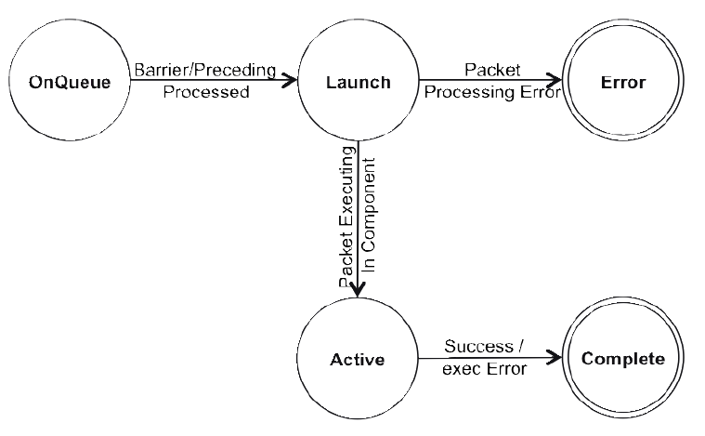
Core Runtime Support for AQL
Dispatch Packet State Diagram

Slide 48
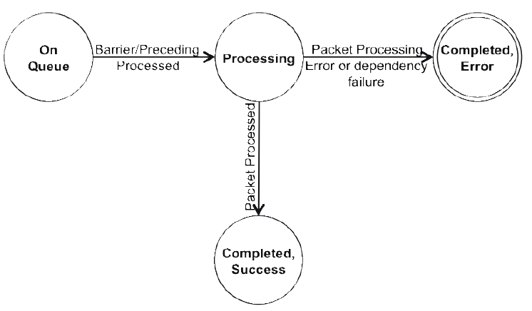
Core Runtime Support for AQL
typedef struct hsa_aql_barrier_packet_s{
hsa_aql_packet_header_t header;
uint32_t reserved2;
uint64_t dep_signal0;
uint64_t dep_signal1;
uint64_t dep_signal2;
uint64_t dep_signal3;
uint64_t dep_signal4;
uint64_t reserved3;
uint64_t completion_signal;
} hsa_aql_barrier_packet_t;
Barrier Packet State Diagram

Slide 49
HSAIL Application Binary Interface
The HSAIL ABI specifies the in-memory format for the kernarg segments
The ABI architects a simple set of rules for the size and alignment of the kernel arguments and ensures that all HSA vendors use a common argument format
Users and tools can determine the offset of all kernel arguments by examining or knowing the kernel signature without any runtime feedback or metadata from the finalizer

Slide 50
HSAIL Application Binary Interface
uint64_t* kernel_arguments =
reinterpret_cast<uint64_t *>(malloc(argument_size));
memset(kernel_arguments, 0, argument_size);
kernel_arguments[0] = (uint64_t)a;
kernel_arguments[1] = (uint64_t)b;
kernel_arguments[2] = (uint64_t)size;
aql_packet.kernarg_address = (uint64_t)kernel_arguments;
kernel &__vector_copy_kernel(
kernarg_u32 %arg_p0,
kernarg_u32 %arg_p1,
kernarg_u32 %arg_p2)
{
…
};

Slide 51
Finalization and Code Object
Compilation support in the HSA core runtime comprises of two parts
The first is the finalization step, the primary functionality of this step is to translate the HSAIL to component specific instruction set and produce a relocatable code object
The second part is support for binding, it resolves user defined symbols that are not already bound

Slide 52
Finalization and Code Object
A code object in memory can be relocatable and position independent
  which indicates that the object can be deep-copied to other memory locations for execution
The HSA runtime provides a query API to verify if a particular component supports position independent kernel code objects

Slide 53
Group Memory Usage
Group memory can be allocated
  statically when the finalizer is called
  dynamically by the user at launch time

Slide 54
Group Memory Usage
Static allocation is supported as follows:
  The has_finalize_brig routine writes the amount of group memory needed by the finalized ISA to the has_code_object_t.workgroup_group_segment_size_byte
  The user copies the requested group segment usage to the AQL dispatch packet’s hsa_aql_dispatch_packet_t.group_segment_size_bytes
  The packet processor reads the group memory usage field and reserves the required resources at dispatch time
  Statically allocated group memory starts at a segment offset of 0

Slide 55
Group Memory Usage
Dynamically allocated group memory allows the user to specify the group memory size when the kernel is launched
The user manually calculates the offset for each kernel argument and passes these as arguments to the HSAIL kernel:
  As above, the hsa_finalize_brig routine returns the requested static group allocation
  HSAIL will use standard 32-bit arguments to specify group segment offsets
  The user must set the AQL dispatch packet’s hsa_aql_dispatch_packet t.group_segment_size_bytes

Slide 56
Group Memory Usage
kernel &myDynamicGroupMemKernel (
kernarg_u32 %groupOffset0,
kernarg_u32 %groupOffset1,
kernarg_u32 %groupOffset2,
kernarg_u32 %foo)
{ …
uint64_t* kernel_arguments =
reinterpret_cast<uint64_t *>(malloc(argument_size));
memset(kernel_arguments, 0, argument_size);
kernel_arguments[0] =
kernel_object_ptr->workgroup_group_segment_size_bytes;
kernel_arguments[1] =
kernel_object_ptr->workgroup_group_segment_size_bytes+size1;
kernel_arguments[2] =
kernel_object_ptr-> workgroup_group_segment_size_bytes+size1+size2;
aql_packet.group_segment_size_bytes = kernel.group_memory_usage +
size1 +
size2 + size3;

Slide 57
Memory Registration
One of the key features of HSA is its ability to share global pointers between the host application and code executing on the device
An application can directly pass a pointer to memory allocated on the host to a kernel function dispatched to a device without an intermediate copy
When a buffer will be accessed by a kernel running on a HSA device, programmers are encouraged to register the corresponding address range beforehand by using the appropriate HSA core API invocation

Slide 58
Memory Registration
While kernels running on HSA devices can access any valid system memory pointer allocated by means of standard libraries (for example, malloc in the C language) without resorting to registration, there might be a performance benefit from registering the buffer with the HSA core component
When an HSA program no longer needs to access a registered buffer in a device, the user should deregister that virtual address range by using the appropriate HSA core API invocation

Slide 59
Memory Registration
void* ptr = malloc(16);
status = hsa_memory_register(ptr, 8);
if(status == HSA_STATUS_ERROR_INVALID_ARGUMENT)
handle_error(status);

Slide 60
Component Local Memory
Component local memory is a memory type that is dedicated specifically for a particular HSA component
This memory could provide higher bandwidth for component access than system memory
Host might not be able to access it directly
HSA provides host interface to allocate/deallocate and access component local memory

Slide 61
Component Local Memory
The result of the allocation is a pointer to an address in application processes address space, which can be accessed directly by the component during kernel execution
const size_t DATA_SIZE = 1024;
void* src_ptr = malloc(DATA_SIZE);
void* dest_ptr = NULL;
hsa_memory_allocate_component_local(DATA_SIZE, device, &dest_ptr);
hsa_memory_copy_component_local_to_system(dest_ptr, src_ptr,
DATA_SIZE);

Slide 62
Execution Control
As per the systems architecture specification, HSA system must support debugging of a HSAIL kernel
The ”block” section could hold debug data and such a section can be placed even within a function
This allows the high-level compiler that generates HSAIL to embed debug specific information
This information makes its way into the ”.debug” section in the brig.

Slide 63
Execution Control
This information can be used for associating a HSAIL level instruction to the higher level functionality
debugtrap_u32 that halts the current wavefront and transfers control to the agent
The single operand to debugtrap_u32, ”src” is passed to the agent and can be used to identify the trap

Slide 64
Execution Control
assert (HSA_STATUS_SUCCESS ==
hsa_signal_wait(queue_ptr->mailbox_signal,
HSA_GREATER_EQUALS, 1));
for(i = 0; i < queue->active_group_global_count; i++) {
assert(HSA_STATUS_SUCCESS ==
hsa_signal_query_acquire(queue->mailbox[i].full_flag,value);
if(value.u64_value == 1){
for(j=0; j < queue->mailbox[i].workgroup_size; j++) {
printf("\n workitemid=%d computeunitid=%d\n",
queue->mailbox[i].workitem_id[j],
queue->mailbox[i].compute_unit_id[j]);
//here we can check PC, etc.
}
hsa_signal_send(queue_ptr->mailbox[i].full_flag, 0);
}
}

Slide 65
Syscall Support
The mailbox described in the Debugging At the Core Level section is also utilized in supporting the HSAIL syscall instruction
The syscall operation in HSAIL is used to call functions that are outsize of the HSAIL Program
The responsibility of the HSA core runtime is to carry this information and provide it to the agent so appropriate action can be taken

Slide 66
Syscall Support
Syscall is unique in that once invoked, unless the function is executed on the host, the control is not returned back to the HSAIL program
syscall requires a synchronous communication with the agent

Slide 67
Syscall Support
syscall_u32 $s1, 3, $s2, $s3, $s4;
syscall_u64 $d1, 10, $d2, 100, $d4;
assert (HSA_STATUS_SUCCESS ==
hsa_signal_wait(queue_ptr->mailbox_signal,
HSA_GREATER_EQUALS, 1));
for(i = 0; i < queue->active_group_global_count; i++) {
if(HSA_STATUS_SUCCESS ==
hsa_signal_poll(queue->mailbox[i].full_flag,HSA_EQUALS, 1))
for(j=0; j < queue->mailbox[i].workgroup_size; j++) {
process_syscall_args(queue->mailbox[i].args,
queue->mailbox[i].workgroup_size);
}
}

Slide 68
HSAIL
Heterogeneous System Architecture Intermediate Language

Slide 69
What is intermediate language?
Intermediate Language (IL) is the language of an abstract machine designed to aid in the analysis of computer programs.
The term comes from their use in compilers, where the source code of a program is translated into a form more suitable for code-improving transformations before being used to generate object or machine code for a target machine.

Slide 70
What is intermediate representation?
Intermediate representation (IR) is a data structure that is constructed from input data to a program, and from which part or all of the output data of the program is constructed in turn.
Use of the term usually implies that most of the information present in the input is retained by the intermediate representation, with further annotations or rapid lookup features.
In some respects, IR and IL is the same.

Slide 71
Examples
In graphic card aspects:
  AMD IL, NVIDIA PTX
  Compiler translate compute kernel into IL form above, and the device driver contains a compiler which translates the IL into binary.
In virtual machine apects:
  Java virtual machine: Java bytecode
  .NET Framework: Common Intermediate Language (CIL)

Slide 72
Examples
In compiler aspects:
  GCC : GENERIC -> GIMPLE ->RTL, GCC uses three main intermediate languages to represent the program during compilation.
  LLVM IR: After parser generate AST, LLVM frontend translate it into LLVM IR and deliver it to the following compilation processes until backend generate machine binary.

Slide 73
What is HSAIL?
a virtual machine and intermediate language called HSAIL (Heterogeneous System Architecture Intermediate Language).
Multiple instruction sets (i.e., CPU(s), GPU(s), specialized processor(s) )
32 bits and 64 bits address space
Allows a single program to execute on a wide range of platforms
Native instruction set has been abstracted away

Slide 74
HSA implementation
Consists of:
Hardware components that execute 1 or more ISAs.
compiler, linker, loader
Finalizer: translate HASIL to native ISA when hardware cannot support HSAIL natively.
Runtime system
Every implementation must can execute same HSAIL VM and language.

Slide 75
HSAIL virtual machine
A heterogeneous collection of processors made up of two kinds of CU.
Latency compute unit
  Both CPU instruction set and HSAIL instruction set
  Derive from CPU processors.
Throughput compute unit
  Only HSAIL instruction set
  Specialized hardware provides very efficient parallel operations
  Derive from GPU or specialized processor(s)

Slide 76
HSAIL virtual machine
Neither kind of compute unit needs to execute HSAIL code directly.
Different implementations can choose to invoke the finalizer at various times:
  Statically at the same time the application is built
  When the application is installed
  When the application loaded
  When application is executing

Slide 77
Types of code
Agent code: written in the latency compute unit ISA.
The code which execute only on latency compute units or the HSAIL code which can execute on either the latency or throughput compute units.
Kernel code: executed in data-parallel by compute unit.
Kernels are written in HSAIL and then separately translated by a finalizer to the target instruction set.
A kernel doesn’t return a value.

Slide 78
HSAIL Virtual Language
HSAIL is a virtual instruction set designed for parallel processing.
Can be translated into many different native instruction set.
Each different HSA implementations can run any program written in HSAIL.
No parallel constructs. Each kernel contains operations for a single work-item.
(the operations in the work-item can launch more work-item.)

Slide 79
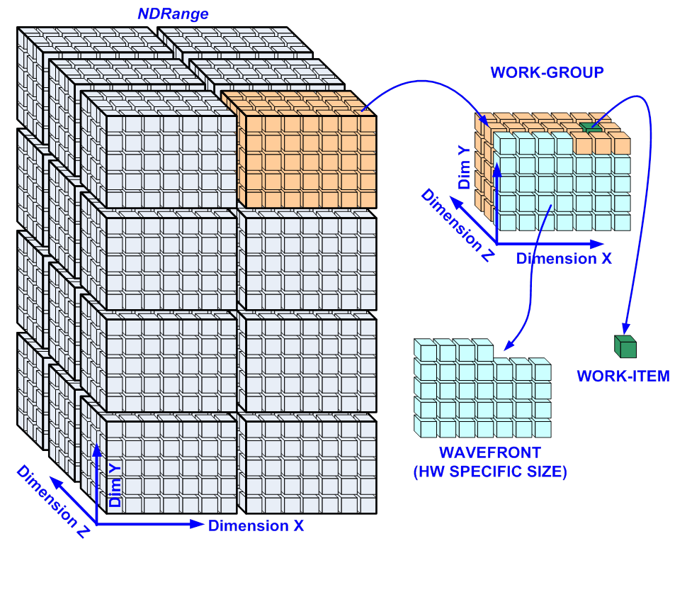
HSAIL Virtual Language
When the kernel starts, a NDRange is defined and one work-item is launched for each point in the NDRange.
A single kernel might launch thousands of work-items.

Slide 80
HSAIL Virtual Language
Each launched work-item executes the same kernel code, but might take different control flow paths.
Execution of the kernel is complete when all work-items of the NDRange have been launched and have completed their execution.
Work-items are extremely lightweight.

Slide 81
HSAIL Virtual Language
HSAIL is a virtual instruction set designed for parallel processing.
Can be translated into many different native instruction set.
Each different HSA implementations can run any program written in HSAIL.
No parallel constructs. Each kernel contains operations for a single work-item.
(the operations in the work-item can launch more work-item.)

Slide 82
HSAIL Virtual Language
HSAIL program looks like a simple RISC-liked assembly program.
HSAIL Operations
  opcode with a set of suffixes(data type, length, others)
  3 operand
  RISC-like constructs
Have pseudo-operations used to declare variables.
All mathematical operations are register-to-register only.
Each HSAIL program has its own set of resources.
For example, each work-item has a private set of registers.

Slide 83
Unified memory model
Unlike prior GPU hardware, HSA has a unified memory model, where all HSAIL work-items and agents can use the same pointers, and a pointer can address any kind of HSA memory.
Programmers are relieved of much of the burden of memory management.
HSA hardware determines if a load or store address should be visible to all devices in the system (global memory), visible only to work-items in a group (group memory), or private to a work-item (private memory).

Slide 84
Unified memory model
The same pointer can be used by both the latency compute unit and the throughput compute unit.
Global memory between the latency and throughput compute units is coherent.

Slide 85
KEY HSAIL FEATURES
Parallel
Shared virtual memory
Portable across vendors in HSA Foundation
Stable across multiple product generations
Consistent numerical results (IEEE-754 with defined min accuracy)
Fast, robust, simple finalization step (no monthly updates)
Good performance (little need to write in ISA)
Supports all of OpenCL™ and C++ AMP™
Support Java, C++, and other languages as well

Slide 86
REGISTERS
Four classes of registers
  C: 1-bit, Control Registers
  S: 32-bit, Single-precision FP or Int
  D: 64-bit, Double-precision FP or Long Int
  Q: 128-bit, Packed data.
Fixed number of registers:
  8 C
  S, D, Q share a single pool of resources
      S + 2*D + 4*Q <= 128
      Up to 128 S or 64 D or 32 Q (or a blend)
Register allocation done in high-level compiler
  Finalizer doesn’t have to perform expensive register allocation

Slide 87
HSAIL INSTRUCTION SET
HSAIL INSTRUCTION SET
  Load-store architecture
  ld_global_u64 $d0, [$d6 + 120]; //$d0= load($d6+120)
  add_u64 $d1, $d2, 24; //$d1= $d2+24
136 opcodes (Java™ bytecode has 200)
  Floating point (single, double, half (f16))
  Integer (32-bit, 64-bit)
  Some packed operations
  Branches
  Function calls
  Platform Atomic Operations: and, or, xor, exch, add, sub, inc, dec, max, min, cas (Synchronize host CPU and HSA Component)
Text and Binary formats (“BRIG”)

Slide 88
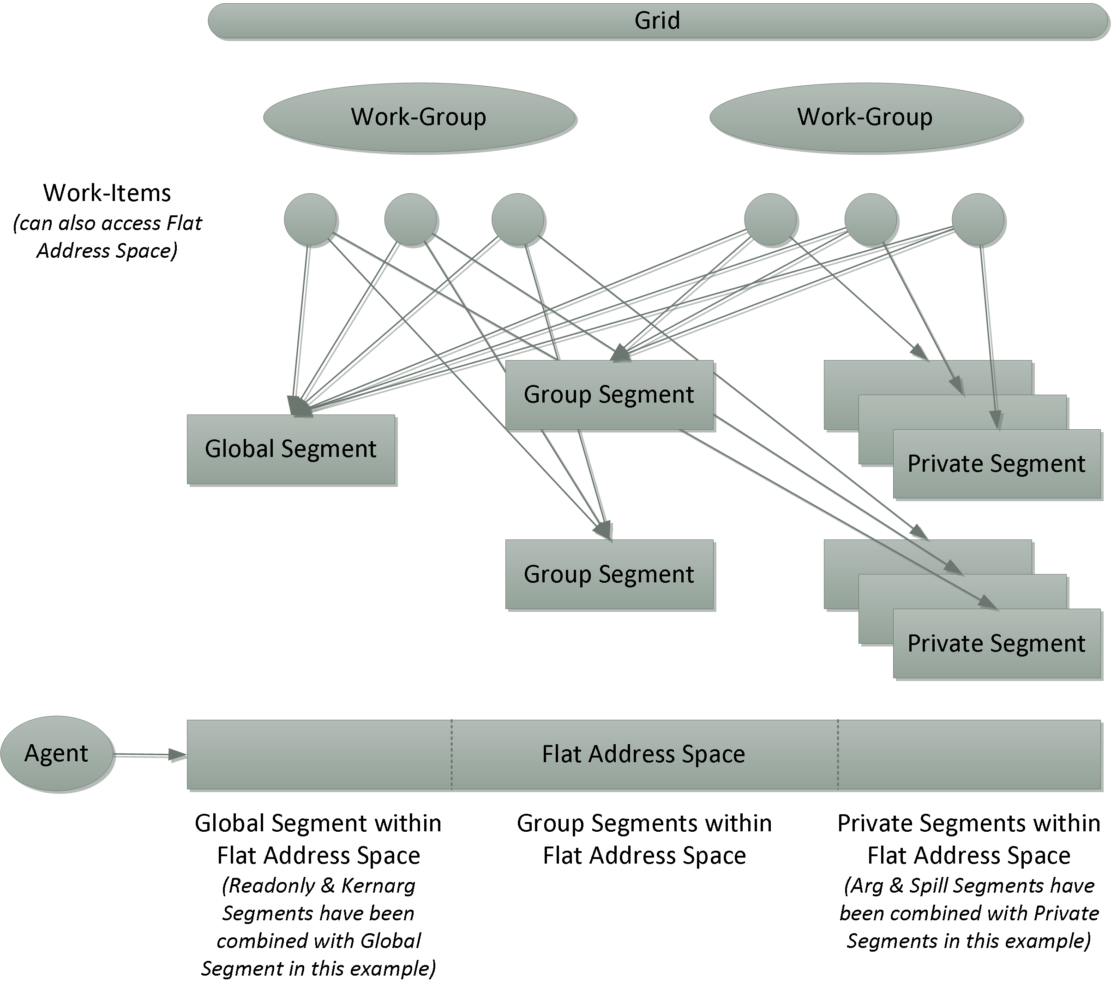
HSA Memory Hierarchy

Slide 89
SEGMENTS AND MEMORY
SEGMENTS AND MEMORY
  global, readonly, group, spill, private, arg, kernarg
  Memory instructions can (optionally) specify a segment
Global Segment
  Visible to all HSA agents (including host CPU)
Group Segment
  Provides high-performance memory shared in the work-group by every work-item
Spill, Private, Arg Segments
  Represent different regions of a per-work-item stack typically generated by compiler
ld_global_u64 $d0, [$d6]
ld_group_u64 $d0,[$d6+24]
st_spill_f32 $s1,[$d6+4]

Slide 90
SEGMENTS AND MEMORY
Kernarg Segment
  Programmer writes kernarg segment to pass arguments to a kernel
Read-Only Segment
  Remains constant during execution of kernel
Flat Addressing
  Each segment mapped into virtual address space
      Flat addresses can map to segments based on virtual address
  Instructions with no explicit segment use flat addressing
  Very useful for high-level language support (ie classes, libraries)
  Aligns well with OpenCL™ 2.0 “generic” addressing feature
ld_kernarg_u64 $d6, [%_arg0]; ld_u64 $d0,[$d6+24] ;

Slide 91
BRIG: HSAIL Binary Format
The BRIG representation describes all aspects of the textual representation of HSAIL except
BRIG format is made up of five sections
  .string — String section, containing all character strings and byte data used in the compilation unit.
  .directive — The directives, which provide information for the finalizer. The directives do not generate code.
  .code — All of the executable operations. Most operations contain offsets to the .operand section.
  .operand — The operands, such as immediate constants, registers, and address expressions, that appear in the operations.
  .debug — The debug information generated by the high-level compiler. The finalizer does not modify the .debug section.

Slide 92
HSAIL Programming Model
Overview of Grids, Work-Groups, and Work-Items
Work-Groups
Work-Items
Scalable Data-Parallel Computing
Active Work-Groups and Active Work-Items
Wavefronts, Lanes, and Wavefront Sizes
Types of Memory
Segments
Flat Memory and Agents
Small and Large Machine Models

Slide 93
Overview of Grids, Work-Groups, and Work-Items
The kernel language runtime can be used to invoke the kernel language compiler that will produce HSAIL.
The HSA runtime can then be used by the language runtime to execute the finalizer for the HSA component that will execute the kernel.
The finalizer takes the HSAIL and produces kernel ISA that will execute on that HSA component.
If the HSAIL requires more resources than are available on the device, it will return a failure result.
For example, the kernel might require more group memory, or more fbarriers than are available on the device.

Slide 94
Overview of Grids, Work-Groups, and Work-Items
An HSA component can have multiple AQL queues associated with it.
Each queue has a queue ID, which is unique across all the queues currently created by the process executing the program.
A request to execute a kernel is made by appending an AQL dispatch packet on a queue associated with an HSA component.
Each dispatch packet is assigned a dispatch ID that is unique for each queue.

Slide 95
Overview of Grids, Work-Groups, and Work-Items
Each HSA component services all the queues associated with it, and dispatches the kernel ISA associated with the queued dispatch packets, which causes the kernel to be executed.
If the HSA component has insufficient resources to execute at least one work-group, then the dispatch fails, no kernel execution occurs, and the dispatch completion object indicates a failure.
For example, the dispatch might request more dynamic group memory than is available. A dispatch may, but is not required to, fail if the dispatch arguments are not compatible with any control directives specified when the kernel was finalized. For example, the dispatch work-group size might not match the values specified by a requiredworkgroupsize control directive.

Slide 96
Overview of Grids, Work-Groups, and Work-Items
The combination of the dispatch ID and the queue ID is globally unique. Operations in a kernel can access these IDs by means of the dispatchid and qid special operations.
The dispatch forms a grid. The grid can be composed of one, two, or three dimensions.
The dimension components are referred to as X, Y, and Z.
If the grid has one dimension, then it has only an X component, if it has two dimensions, then it has X and Y components, and if it has three dimensions, then it has X, Y, and Z components.

Slide 97
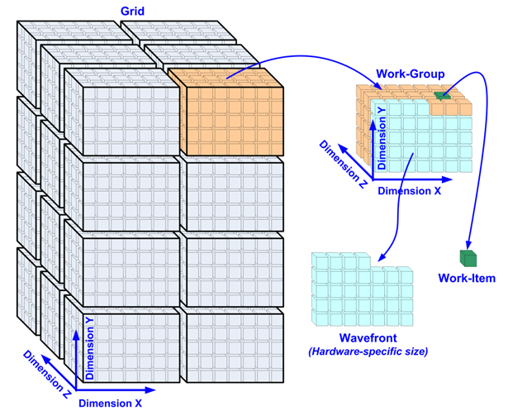
Overview of Grids, Work-Groups, and Work-Items
A grid is a collection of work-items.
The work-items in the grid are partitioned into work-groups that have the same number of dimensions as the grid.
A work-group is an instance of execution on the HSA component. Execution is performed by a compute unit. An HSA component can have one or more compute units.

Slide 98
Overview of Grids, Work-Groups, and Work-Items
When a kernel is dispatched, the number of dimensions of the grid (which is also the number of dimensions of the work-group), the size of each grid dimension, the size of each work-group dimension, and the kernel argument values must be specified.
If the number of dimensions specified for a kernel dispatch is 1, then the Y and Z components for the grid and work-group size must be specified as 1; if the number of dimensions specified for a kernel dispatch is 2, then the Z component for the grid and work-group size must be specified as 1.

Slide 99
Overview of Grids, Work-Groups, and Work-Items
As execution proceeds, the work-groups in the grid are distributed to compute units.
All work-items of a work-group are executed on the same compute unit at the same time, each work-item running the kernel.
Execution can be either concurrent, or through some form of scheduling.
The grid size is not required to be an integral multiple of the work-group size, so the grid might contain partial work-groups. In a partial work-group, only some of the work-items are valid.
The compute unit will only execute the valid work-items in a partial work-group.

Slide 100
Overview of Grids, Work-Groups, and Work-Items
A compute unit may execute multiple work-groups at the same time.
The resources used by a work-group (such as group memory, barrier and fbarrier resources, and number of wavefronts that can be scheduled) and work-items within the work-group (such as registers) may limit the number of work-groups that a compute unit can execute at the same time.
However, a compute unit must be able to execute at least one work-group.
If an HSA component has more than one compute unit, different work-groups may execute on different compute units.

Slide 101
Overview of Grids, Work-Groups, and Work-Items
In the figure, the grid is composed of 24 work-groups. (Dimension X = 2, dimension Y = 4, and dimension Z = 3.)
In the figure, each work-group is a three-dimensional work-group, and each work-group is composed of 105 work-items. (Dimension X = 7, dimension Y = 5, and dimension Z = 3.)

Slide 102
Work-Groups
A work-group is an instance of execution in a compute unit.
A compute unit must have enough resources to execute at least one work-group at a time.
Thus, it is not possible for a compute unit to be too small.
Assorted synchronization operations can be used to control communication within a work-group.
For example, it is possible to mark barrier synchronization points where work-items wait until other work-items in the work-group have arrived.

Slide 103
Work-Groups
All implementations can execute at least the number of work-items in a work-group such that they are all guaranteed to make forward progress in the presence of work-group barriers.
Implementations that provide multiple compute units or more capable compute units can execute multiple work-groups simultaneously.

Slide 104
Work-Group ID
Every work-group has a multidimensional identifier containing up to three integer values (for the three dimensions) called the work-group ID. The work-group ID is calculated by dividing each component of the work-item absolute ID by the corresponding work-group size component and ignoring the remainder.
Work-group size is the product of the three dimensions:
  work-group size = workgroupsize₀ * workgroupsize₁ * workgroupsize₂
Each work-group can access assorted predefined read-only values such as work-group ID, work-group size, and so forth through the use of special operations.

Slide 105
Work-Group ID
The value of the work-group ID is returned by the workgroupid operation.
The size of the work-group specified when the kernel was dispatched is returned by the workgroupsize operation.
Because the grid is not required to be an integral multiple of the work-group size, there can be partial work-groups.
The currentworkgroupsize operation returns the work-group size that the current work-item belongs to.
The value returned by this operation will only be different from that returned by workgroupsize operation if the current work-item belongs to a partial work-group.

Slide 106
Work-Group Flattened ID
Each work-group has a work-group flattened ID.
The work-group flattened ID is defined as:
  work-group flattened ID = work-item flattened absolute ID / work-group size
HSAIL implementations need to ensure forward progress.
That is, any program can count on one-way communication and later work-groups (in work-group flattened ID order) can wait for values written by earlier work-groups without deadlock.

Slide 107
Work-Items
Each work-item has its own set of registers, has private memory, and can access assorted predefined read-only values such as work-item ID, work-group ID, and so forth through the use of special operations.
To access private memory, work-items use regular loads and stores, and the HSA hardware will examine addresses and detect the ranges that are private to the work-item.
One of the system-generated values tells the work-item the address range for private data.

Slide 108
Work-Items
To access private memory, work-items use regular loads and stores, and the HSA hardware will examine addresses and detect the ranges that are private to the work-item.
One of the system-generated values tells the work-item the address range for private data.

Slide 109
Work-Item ID
Each work-item has a multidimensional identifier containing up to three integer values (for the three dimensions) within the work-group called the work-item ID.
max is the size of the work-group or 1
For each dimension i, the set of values of ID_{i} is the dense set [0, 1, 2, ... max_{i} −1].
The value of max_{i} can be accessed by means of the special operation workgroupsize.
The work-item ID can be accessed by means of the special operation workitemid.

Slide 110
Work-Item Flattened ID
The work-item ID can be flattened into one dimension, which is relative to the containing work-group. This is called the work-item flattened ID.
The work-item flattened ID is defined as:
work-item flattened ID = ID₀ + ID₁ * max₀ + ID₂ * max₀ * max₁
where:
  ID₀ = workitemid (dimension 0)
  ID₁ = workitemid (dimension 1)
  ID₂ = workitemid (dimension 2)
  max₀ = workgroupsize (dimension 0)
  max₁ = workgroupsize (dimension 1)
The work-item flattened ID can be accessed by means of the special operation workitemflatid.

Slide 111
Work-Item Absolute ID
Each work-item has a unique multidimensional identifier containing up to three integer values (for the three dimensions) called the work-item absolute ID. The work-item absolute ID is unique within the grid.
Programs can use the work-item absolute IDs to partition data input and work across the work-items.
For each dimension i, the set of values of absloute ID_{i} is the dense set [0, 1, 2, ... max_{i} −1].
The value of max_{i} can be accessed by means of the special operation gridsize.
The work-item absolute ID can be accessed by means of the special operation workitemabsid.

Slide 112
Work-Item Flattened Absolute ID
The work-item absolute ID can be flattened into one dimension into an identifier called the work-item flattened absolute ID. The work-item flattened absolute ID enumerates all the work-items in a grid.
The work-item flattened ID is defined as:
work-item flattened absolute ID = ID₀ + ID₁ * max₀ + ID₂ * max₀ * max₁
where:
  ID₀ = workitemabsid (dimension 0)
  ID₁ = workitemabsid (dimension 1)
  ID₂ = workitemabsid (dimension 2)
  max₀ = gridsize (dimension 0)
  max₁ = gridsize (dimension 1)
The work-item flattened absolute ID can be accessed by means of the special operation workitemflatabsid.

Slide 113
Scalable Data-Parallel Computing
For CPU developers, the idea of work-items and work-groups might seem odd, because one level of threads has traditionally been enough.
Work-items are similar in some ways to traditional CPU threads, because they have local data and a program counter. But they differ in a couple of important ways:
    Work-items can be gang-scheduled while CPU threads are scheduled separately.
    Work-items can be gang-scheduled while CPU threads are scheduled separately.

Slide 114
Scalable Data-Parallel Computing
The number of work-groups that can be processed at once is dependent on the amount of hardware resources.
Adding work-groups makes it possible to abstract away this concept so that developers can apply a kernel to a large grid without worrying about fixed resources.
If hardware has few resources, it executes the work-groups sequentially.
But if it has a large number of compute units, it can process them in parallel.

Slide 115
Active Work-Groups and Active Work-Items
At any instance of time, the work-groups executing in compute units are called the active work-groups. When a work-group finishes execution, it stops being active and another work-group can start. The work-items in the active work-groups are called active work-items. Resource limits, including group memory, can constrain the number of active work-groups.
An active work-item at an operation is one that executes the current operation. For example:
if (condition) {
operation;
}
The active work-items at this operation are the work-items where condition was true.

Slide 116
Active Work-Groups and Active Work-Items
Resource limits might constrain the number of active work-items.
However, every HSAIL implementation must be able to support enough active work-items to be able to execute at least one maximum-size work-group.
Resources such as private memory and registers are not persistent over work-items, so implementations are allowed to reuse resources.
When a work-group finishes, it and all its work-items stop being active and the resources they used (private memory, registers, group memory, hardware resources used to implement barriers, and so forth) might be reassigned.

Slide 117
Active Work-Groups and Active Work-Items
Work-group (i +j) might start after work-group (i) finishes, so it is not valid for a work-group to wait on an operation performed by a later work-group.
When a work-group finishes, the associated resources become free so that another work-group can start.

Slide 118
Wavefronts, Lanes, and Wavefront Sizes
Work-items within a work-group can be executed in an extended SIMD (single instruction, multiple data) style. That is, work-items are gang-scheduled in chunks called wavefronts. Executing work-items in wavefronts can allow implementations to improve computational density.
Work-items are assigned to wavefronts in work-item flattened absolute ID order: X then Y then Z. This can be useful to expert programmers.
A lane is an element of a wavefront. The wavefront size is the number of lanes in a wavefront. Wavefront size is an implementation-defined constant, and must be a power of 2 in the range from 1 to 64 inclusive. Thus, a wavefront with a wavefront size of 64 has 64 lanes.

Slide 119
Wavefronts, Lanes, and Wavefront Sizes
If the work-group size is not a multiple of the wavefront size, the last wavefront will have extra lanes that do not contribute to the computation.
Two work-items in the same work-group will be in the same wavefront if the floor of work-item flattened absolute ID / wavefront size is the same.

Slide 120
Wavefront Size
On some implementations, a kernel might be more efficient if it is written with knowledge of the wavefront size.
Thus, HSAIL includes a compile-time macro, WAVESIZE, which can be used in any operation where an integer or bit immediate valueis allowed, and as the argument to the width modifier.
WAVESIZE is only available inside the HSAIL code.
Developers need to be careful about wavefront size assumptions, because programs coded for a single wavefront size could generate wrong answers or deadlock if the code is executed on implementations with a different wavefront size.
The grid size does not need to be an integral multiple of the wavefront size.

Slide 121
Types of Memory
HSAIL memory is organized into three types:
Flat memory: Flat memory is a simple interface using byte addresses. Loads and stores can beused to reference any visible location in the flat memory.
Registers: 1bit, 32bit, 64bit, 128bit.
  Registers are untyped.
Image memory
  Image memory is a special kind of memory access that can make use of dedicatedhardware often provided for graphics.
  Only programmers seeking extreme performance need to understand image memory.

Slide 122
Segments
Flat memory is divided into segments based on:
  The way data can be shared
  The intended usage
A segment is a block of memory. The characteristics of a segment space include its size, addressability, access speed, access rights, and level of sharing between work-items.
The segment determines the part of memory that will hold the object, how long the storage allocation exists, and the properties of the memory. The finalizer uses the segment to determine the intended usage of the memory. There is no bounds checking over segments.
No access protection between segments is provided. That is, the behavior is undefinedwhen memory operations generate addresses that are outside the bounds of a segment.

Slide 123
Types of Segments (7 types of segments)
Global
  Memory that is visible to all work-groups and to all agents.
  This segment supports read/write access for all work-items in all work-groups. All agents including HSA components can read and write global memory.
  All global memory is persistent across the application.

Slide 124
Types of Segments (7 types of segments)
Group
  Memory that is visible to a single work-group.
  This segment can be used to hold variables that are shared by all work-items in a work-group. An address in group memory can be read and written by any work-item in the group.
  If an implementation uses regular memory to implement group memory, it must adjust the group segment addresses used by work-items in one work-group so that accesses by work-items in a different work-group access different memory locations for the same group segment address.
  Group memory is uninitialized when the work-group starts execution.
  It is undefined whether or not group memory is visible to other agents.
  One specific implementation-defined range of flat addresses is reserved for group memory.

Slide 125
Types of Segments (7 types of segments)
Private
  Memory that is visible only to a single work-item.
  Although it is permitted for an implementation to allow other work-items to access the values in a different work-item's private memory, a program is undefined if it does so. For example, an implementation may use global memory to implement private memory and so a work-item could use a global or flat address to access the private memory of any work-item.
  If an implementation uses regular memory to implement private memory, it must adjust the private segment addresses used by each work-item so that different work-items access different memory locations for the same private segment address.
  It is implementation-defined whether or not private memory is visible to other agents.

Slide 126
Types of Segments (7 types of segments)
Private
  Private memory is uninitialized when the work-item starts. The finalizer is free to remove loads and stores to private memory if this does not change the single work-item answer without regard to exceptions. For example, a floating-point divide can be removed if its only effect is to cause a divide by zero exception.

Slide 127
Types of Segments (7 types of segments)
Kernarg
  Read-only memory used to pass arguments into a kernel.
  Implementations are allowed either to provide special hardware or to use kernarg memory.
  Implementations are allowed to treat kernarg and global memory as though they are a single segment.
Readonly
  Read-only memory.
  Readonly memory remains constant during the execution of a kernel.
  The result of a store or atomic operation to readonly memory (such as by using a flat address) is undefined, and it is implementation-defined if such accesses will be detected and generate an exception.
  Implementations are allowed to treat readonly and global memory as though they are a single segment.
  The finalizer might place a variable in readonly memory in specialized read-only caches.

Slide 128
Types of Segments (7 types of segments)
Spill
  Memory that is visible only to a single work-item.
  Used to load or store register spills. This segment is used as a hint to the finalizer so it can generate better code.
  The finalizer might remove operations using the spill segment.
  Implementations are allowed to treat spill and private memory as though they are a single segment.
Arg
  Memory that is visible only to a single work-item.
  Used to pass arguments into and out of functions.
  Implementations are allowed to provide special hardware to accelerate arg memory.
  Implementations are allowed to treat arg and private memory as though they are a single segment.

Slide 129
Shared Virtual Memory
A single work-item sees a flat address space.
  Within that address space, certain address ranges are group memory, other ranges are private, and so on. Implementations use the address to determine the kind of memory. Consequently, compilers need not generate special forms of loads and stores for each type of memory. Pointers to memory can be freely cast to integer and back without problems.
Non-shared objects are hidden.
  This means that each object is declared to be in one of three sharing levels: shared over all work-items (global), shared over the work-group (group), or never shared (private).
  The private segments for each work-item overlay. Overlaying means that reads and writes to address X in work-item 1 access work-item 1's private data, while reads and writes to the same address X in work-item 2 access different storage.
  Thus, if work-item 1 declares a private variable at address X, then work-item 2 cannot read or write the variable. (Spill segments behave in the same way.)

Slide 130
Shared Virtual Memory
Non-shared objects are hidden.
  Similarly, every work-group sees only its own group segment, which is shared by the work-items within the work-group, so no work-group can access the group memory of another work-group.
  Every work-item and agent sees the same global memory.

Slide 131
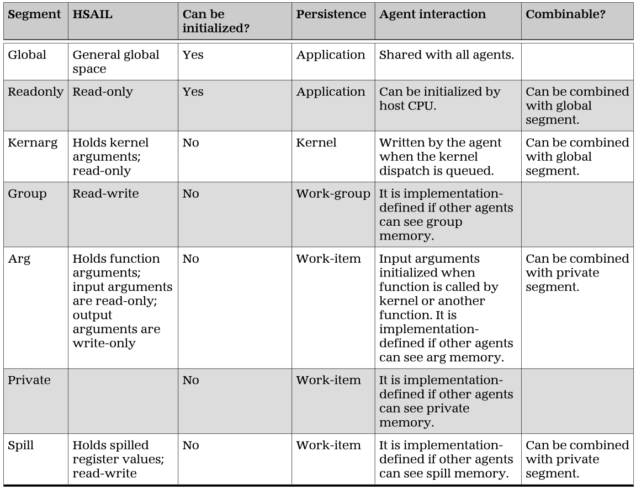
Flat Memory and Agents

Slide 132
Flat Memory and Agents
The same global and readonly segment address, and its corresponding flat address, can be used in two different work-items (which can be in different kernels and different dispatches of the same kernel) and in an agent to access the same memory location. Standard page protections (read-only/read-write/protected, and so forth) apply to global and readonly segment memory.
An implementation is not required to use read-only protection on the readonly segment variables.
Global and readonly memory may be visible to agents. Runtime libraries can provide a way for applications to indicate that some global memory is not accessible to agents.

Slide 133
Flat Memory and Agents
An implementation can map group addresses to special scratchpad memory allocated for each HSA component compute unit, to addresses in global memory, or to addresses in other agent memory. It is implementation-defined whether or not other agents can access group memory.
Private, spill, and arg memory can be expanded to multiple addresses in the address space (one for every active work-item) or can be implemented by special hardware.
It is implementation-defined whether or not other agents can access private, spill, or arg memory.

Slide 134
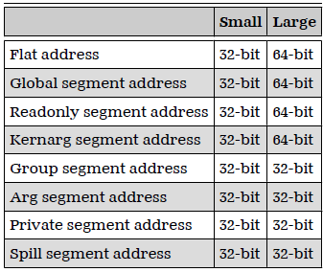
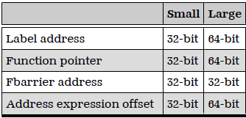
Small and Large Machine Models
HSAIL supports two machine models. Machine models determine the size of a data pointer and are not compatible.

Slide 135
HSAIL Instructions
Arithmetic Operations
Memory Operations
Image Operations
Branch Operations
Parallel Synchronization and Communication Operations
Functions
Operations Related to Functions
Special Operations
Exceptions

Slide 136
Arithmetic Operations
Unless stated otherwise, arithmetic operations expect all inputs to be in registers, immediate values, or WAVESIZE, and to produce a single result in a register.
An overflow occurs when an arithmetic operation attempts to create a numeric value that is larger than the value that can be represented. Integer overflow stores the least significant bits of the results. Floating-point overflow follows the rules of the IEEE/ANSI Standard

Slide 137
Memory Operations
Memory operations transfer data between registers and memory:
  The load operations move contents from memory to a register.
  The store operations move contents of a register into memory.
  The atomicReturn operations read a value from memory, update the memory location, and set the destination to the original value.
  The atomicNoReturn operations read a value from memory and update the memory location. (They do not have a destination.)

Slide 138
Image Operations
Images are a graphics feature that can sometimes be useful in data-parallel computing. Image memory is a special kind of memory access that can make use of dedicated hardware often provided for graphics. Many implementations will provide such dedicated hardware to speed up image operations.
For background information, see the OpenCL™ Specification: http://www.khronos.org/registry/cl/specs/opencl-1.1.pdf.

Slide 139
Image Operations(Cont.)
An image is an array of one, two, or three dimensions.
Each element in an image has four values called components. The components are named rgba.
Each element in the image has the same format.
Each image has a fixed size for each dimension.
Associated with each image are two objects:
  An image object that describes how the image is structured.
  A sampler object that describes how a particular read is to be performed.

Slide 140
Branch Operations
Like many programming languages, HSAIL supports branch operations that can alter the control flow.
The branch operations are:
  brn, Unconditional branch
  cbr, Conditional branch

Slide 141
Branch Operations
Direct Branches
Indirect Branches
brn, transfers control to a label.
cbr, checks a source and transfers control to either the label (if the source is true), or the statement after the cbr (if the source is false).
All work-items take the branch, but because the target is in a register, they can go to different targets.

Slide 142
Parallel Synchronization and Communication Operations
There are two memory segments that can be synchronized with a memory fence: the group segment and the global segment.
The barrier operation is used to synchronize work-item execution in a work-group and optionally act as a memory fence.
Fbarriers are used to synchronize only between work-items within a work-group that are wavefront uniform.
The sync operation makes sure that the writes in the program preceding the sync have been fully committed to memory before the program continues.
Cross-Lane Operations perform work across lanes in a wavefront, Ex. masklane_b64

Slide 143
Functions
Like other programming languages, HSAIL provides support for user functions.
In order that HSAIL can execute efficiently on a wide range of compute units, an abstract method is used for passing arguments, with the finalizer determining what to do. This is necessary because, on a GPU, stacks are not a good use of resources, especially if each work-item has its own stack.
Functions cannot be nested, but functions can be recursive.

Slide 144
Operations Related to Functions
The call operation stores the address of the next operation, so execution can resume at that point after executing a ret operation.
The syscall operation is used to call runtime library-supplied functions that will be executed by a host CPU.
The allocate memory (alloca) operation is used by kernels or functions to allocate per-work-item private memory at run time.

Slide 145
Special Operations
Some special operations are relation of HW or NDRange model
Ex.
  maxwaveid, returns the number of wavefronts −1 that can run at the same time on a compute unit and stores the result in the destination dest.
  workitemid, accesses the work-item identifier (ID) within the work-group and stores the result in the destination dest.

Slide 146
Exceptions
Three kinds of exceptions are supported:
  Hardware-detected exceptions such as divide by zero.
  Software-triggered exceptions corresponding to the higher-level catch and throw operations. Software exceptions can be generated by syscall
  Debug-related exceptions generated by debugtrap. Debug exceptions normally invoke the debugger. If no debugger is present, they are handled as software exceptions.

Slide 147
Reference
HSA Programmer’s Reference Manual: HSAIL Virtual ISA and Programming Model, Compiler Writer’s Guide, and Object Format (BRIG) 0.95
HSA Programmer's Reference Manual 1.2
AMD Developer Central
HSA Foundation

